Slide 1

Classification of Histopathological Breast cancer images using Deep Learning
Rishab Kumar
1701EE39
Under the guidance of Dr. M H Kolekar

Slide 2
Introduction
Histopathological images
Mammogram images
Extracted feature based data
Ultrasounds
MRI images
Certain types of breast cancer images
Histopathological images from ICIAR2018 dataset

Slide 3
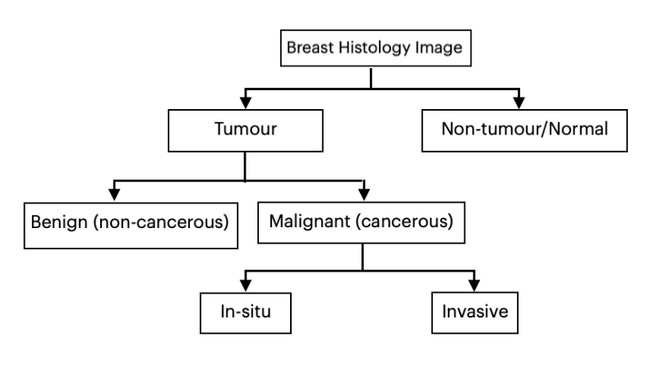
Classification of breast histology images

Slide 4
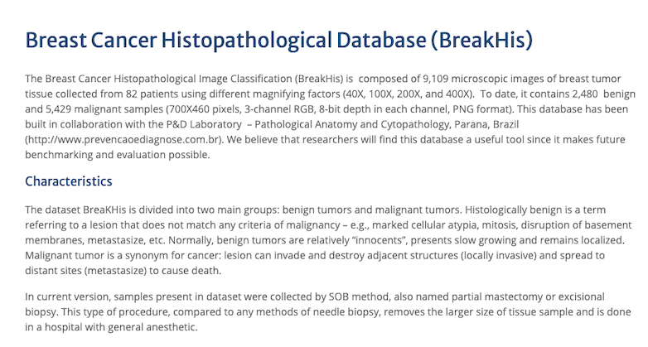
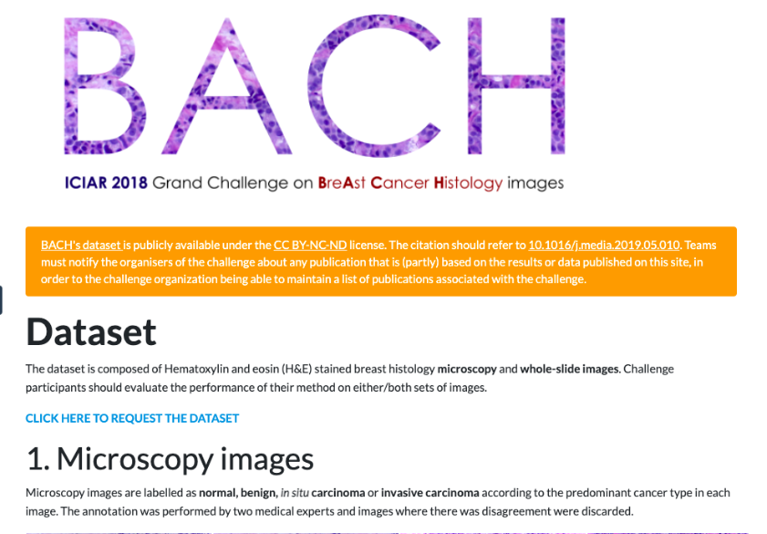
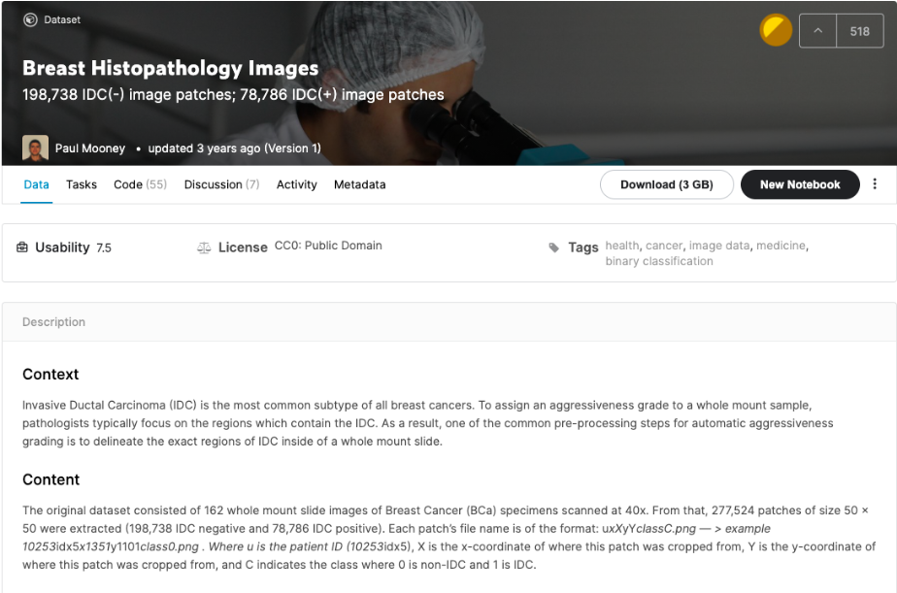
Datasets
Three standard datasets were chosen for training and testing purposes
Breakhis Dataset
ICIAR2018 Dataset
Kaggle Breast Histology Images Dataset
Breakhis ICIAR2018 Kaggle BHI

Slide 5
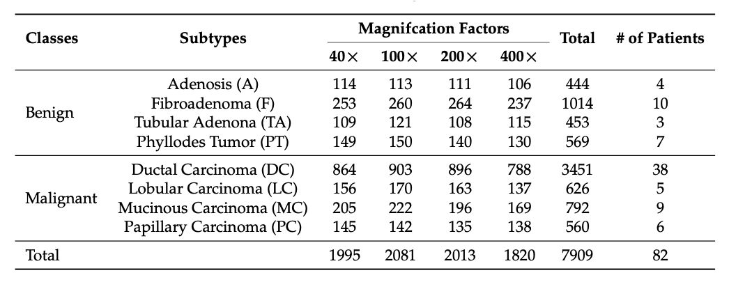
Breakhis dataset

Slide 6
Methodology
Used DenseNet201 with some additional layers as the proposed model
Why DenseNet201 ?
It has shown magnificent results in certain image classification problems.
It is a pre-built convolutional neural network having 201 layers.
The features of histopathological image are very complex, deep model is required
Has shown excellent results in CIFAR-10, CIFAR-100, SVHN, and ImageNet datasets

Slide 7
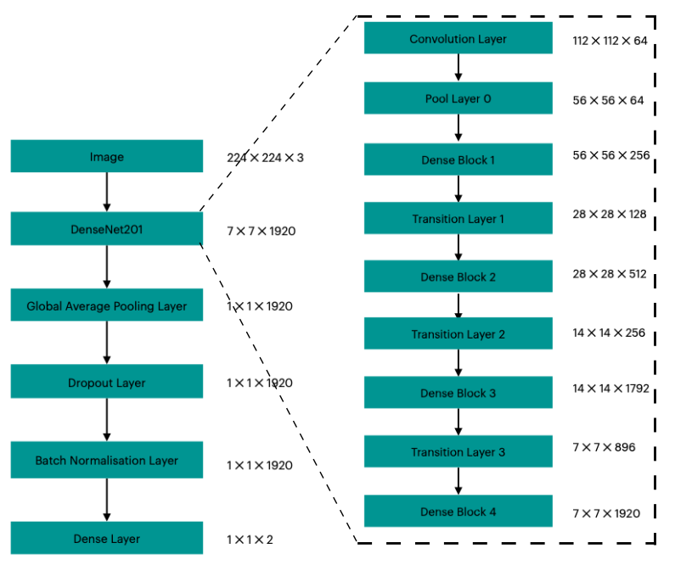
Model
details

Slide 8
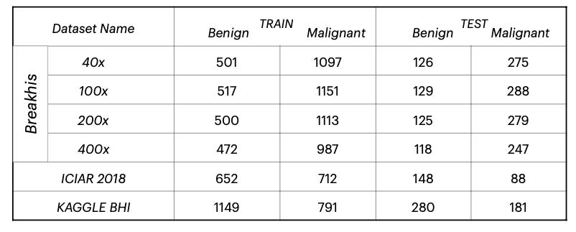
Training
80% training
20% testing
Batch size : 16
Epochs: 20

Slide 9
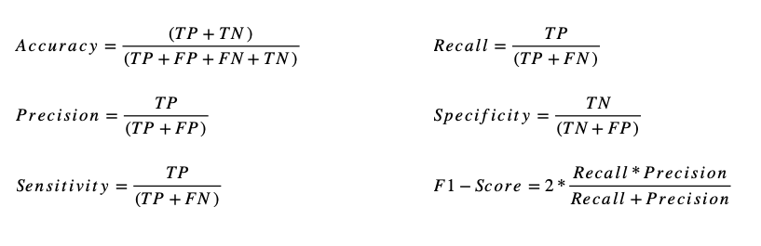
Performance measures
Positive is taken as MALIGNANT and negative is taken as BENIGN

Slide 10
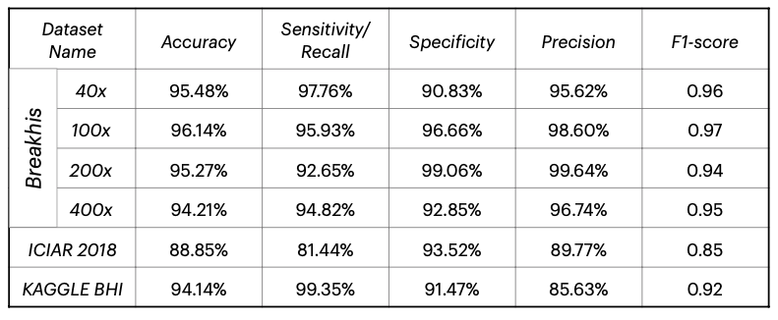
RESULT

Slide 11
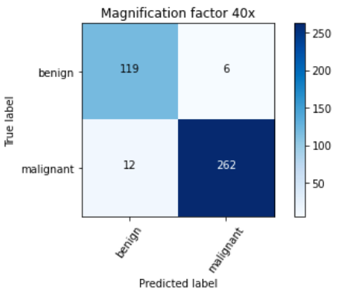
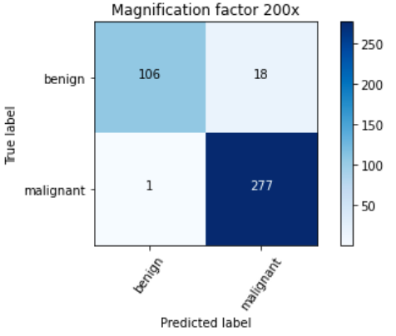
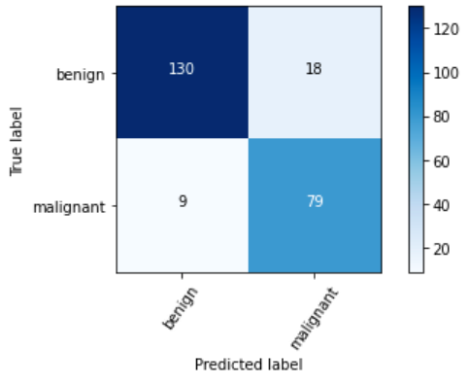
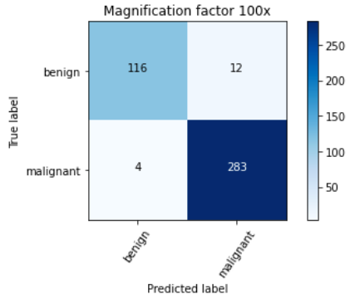

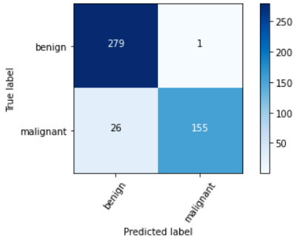
RESULT
ICIAR2018
Kaggle BHI
Breakhis

Slide 12

COMPARISON FROM OTHER MODELS
PAPER [1] shows accuracy of 90%, 90%, 91%, 90% for 40x, 100x, 200x and 400x respectively on breakhis dataset.
PAPER [2] shows 89.6 ± 6.5%, 85.0 ± 4.8%, 84.0 ± 3.2%, 80.8 ± 3.1% for 40x, 100x, 200x and 400x respectively on breakhis dataset.
PAPER [4] shows an accuracy of 93% on breakhis dataset.
PAPER [5] shows accuracies of different models as 90.0 ± 6.7%, 85.36%, 92.19% and 91.0% on breakhis dataset
PAPER [6] shows the accuracy of 94.71% on the breakhis dataset for the most efficient model.

Slide 13
Conclusions
The proposed model achieved an average accuracy of 95.27% on the breakhis dataset, 88.85% on the ICIAR2018 dataset and 94.14% on Kaggle BHI dataset
The proposed model has performed very good as comparable to the existing models.
Certain changes to the layers placed after the DenseNet201 can increase the accuracy.
Future work can be to extend this for non-binary classification as the malignant class also contains 2 sub classes and add some good data augmentation techniques for the ICIAR2018 dataset to increase its accuracy

Slide 14
References
Histopathological Breast Cancer Image Classification by Deep Neural Network Techniques Guided by Local Clustering, 2018.
Breast cancer histopathological image classification using convolutional neural networks, 2016.
Breast cancer classification using digital biopsy histopathology images through transfer learning., 2019.
Breast Cancer Multi-classification through Deep Neural Network and Hierarchical Classification Approach, 2020.
Deep learning-based breast cancer classification through medical imaging modalities: state of the art and research challenges, 2020.
Breast Tumor Classification Using an Ensemble Machine Learning Method, 2020.
Prediction of benign and malignant breast cancer using data mining techniques. Journal of Algorithms & Computational Technology, 2018.
Histopathological Classification of Breast Cancer Images Using a Multi-Scale Input and Multi-Feature Network, 2020
Dataset for Breast Cancer Histopathological Image Classification, 2016.
Breast Histopathology Images, 198,738 IDC(-) image patches; 78,786 IDC(+) image patches, 2018.
BACH: Grand challenge on breast cancer histology images, Medical Image Analysis, 2019.

Slide 15
Thank you

